Slide 1
UNIVERSITY INSTITUTE OF ENGINEERING
Department of Computer Science & Engineering
Databases Management System
(23CSH-205/23ITH-205)
DR. GITANJALI
E16525
ASSISTANT PROFESSOR
CSE
DISCOVER . LEARN . EMPOWER

Slide 2
ABOUT COURSE
The main DBMS course, we learn about the structural formation of data, maintain data integrity, multitasking with concurrent access and recovery without occurring crashes, data structures, data models etc. and their working in which every organization is based.
At the end of the course, the students may understand the concepts of data structures, data models and design, construction of queries by using SQL, uses and applications of database design etc

Slide 3
COURSE OUTCOMES
CO No. | Title | BT Level
CO1 | Students will be able to understand the database system concepts and design databases for different applications. | Memorize
CO2 | Students will be able to identify different types of DDL, DML, DCL and TCL commands and their usage. | Understanding
CO3 | Students will be able to classifying Normalization, Dependencies and Denormalization along with their requirements. | Apply
CO4 | Students will be able to analyse and Compare Transaction Processing techniques and Recovery techniques. | Analyze
CO5 | Students will be able to evaluate database performance after implementing Triggers, procedures, packages, cursors and views. | Evaluate
Will be covered in this lecture

Slide 4
COURSE OBJECTIVES
This course will enable students to,
To have good understanding of database system concepts and design databases for different applications.
To learn how to use a DBMS and RDBMS.
To implement and understand different types of DDL, DML and DCL statements.
To understand transaction concepts related to databases and recovery/backup techniques required for the proper storage of data.

Slide 5

Topics covered
Control Structures :
Introduction to conditional control, Iterative control and sequential control statements, Cursors, Views.

Slide 6

PL/SQL Conditional Statements
PL/SQL (Procedural Language/Structured Query Language) is an extension of SQL used in Oracle databases to write procedural code. It includes various conditional statements that allow developers to execute different blocks of code based on specific conditions. Decision-making statements in programming languages decide the direction of the flow of program execution. Conditional Statements available in PL/SQL are defined below:
IF THEN
IF THEN ELSE
NESTED-IF-THEN
IF THEN ELSIF-THEN-ELSE Ladder

Slide 7
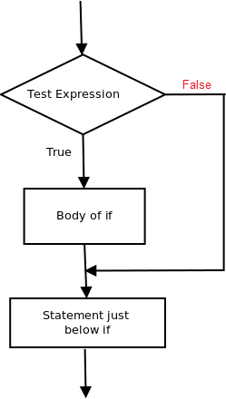
PL/SQL Conditional Statements
1. IF THEN
If then the statement is the simplest decision-making statement. It is used to decide whether a certain statement or block of statements will be executed or not i.e if a certain condition is true then a block of statement is executed otherwise not.
Syntax:
if condition then
-- do something
end if;

Slide 8
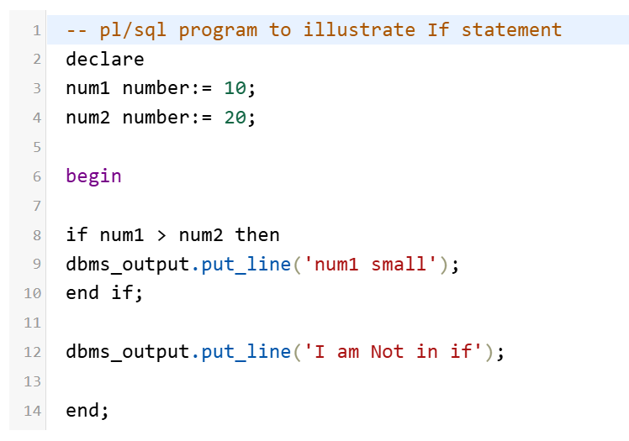
PL/SQL Conditional Statements
As the condition present in the if statement is false. So, the block below the if statement is not executed.
Output:
I am Not in if

Slide 9
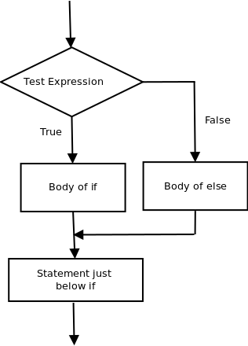
PL/SQL Conditional Statements
2. IF THEN ELSE
The if statement alone tells us that if a condition is true, it will execute a block of statements and if the condition is false, it won’t. But what if we want to do something else if the condition is false. Here comes the else statement. We can use the else statement with if statement to execute a block of code when the condition is false.
Syntax:-
if (condition) then
-- Executes this block if
-- condition is true
else
-- Executes this block if
-- condition is false
if

Slide 10
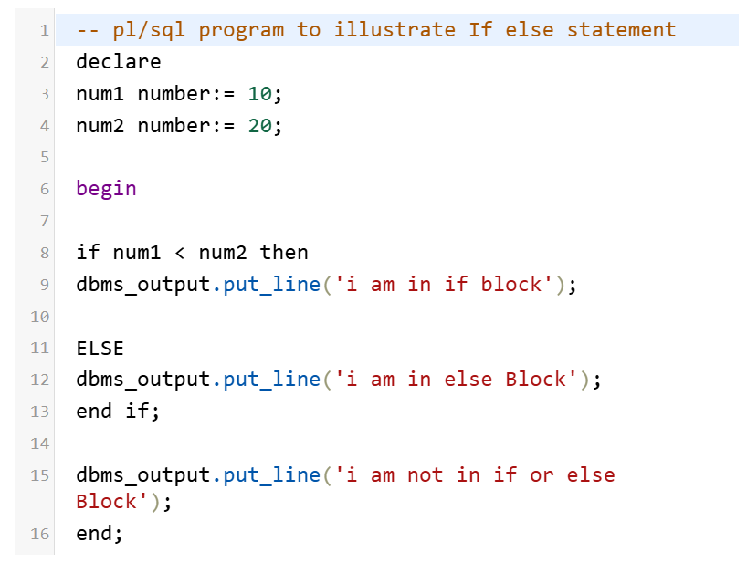
PL/SQL Conditional Statements
Output:-
i'm in if Block
i'm not in if and not in else Block
The block of code following the else statement is executed as the condition present in the if statement is false after calling the statement which is not in block(without spaces).

Slide 11
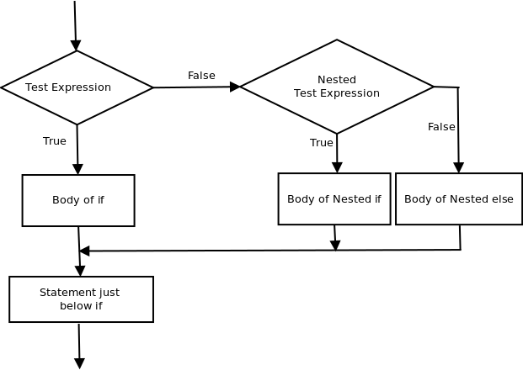
PL/SQL Conditional Statements
3. NESTED-IF-THEN
A nested if-then is an if statement that is the target of another if statement. Nested if-then statements mean an if statement inside another if statement. Yes, PL/SQL allows us to nest if statements within if-then statements. i.e, we can place an if then statement inside another if then statement. Syntax:-
if (condition1) then
-- Executes when condition1 is true
if (condition2) then
-- Executes when condition2 is true
end if;
end if;

Slide 12
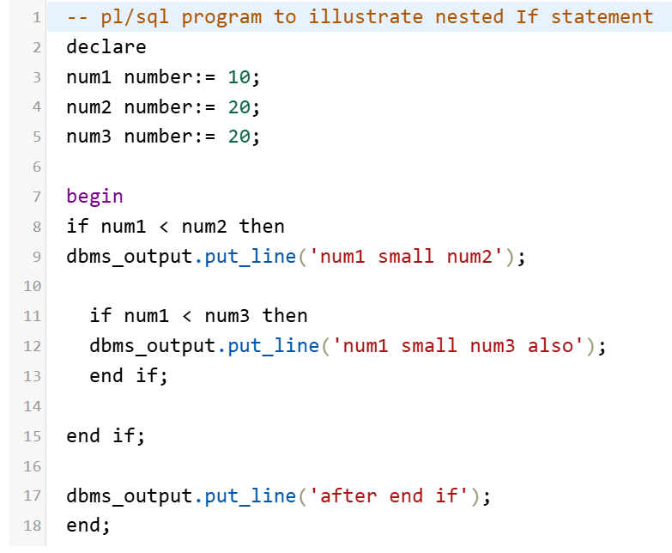
PL/SQL Conditional Statements
Output:-
num1 small num2
num1 small num3 also
after end if

Slide 13
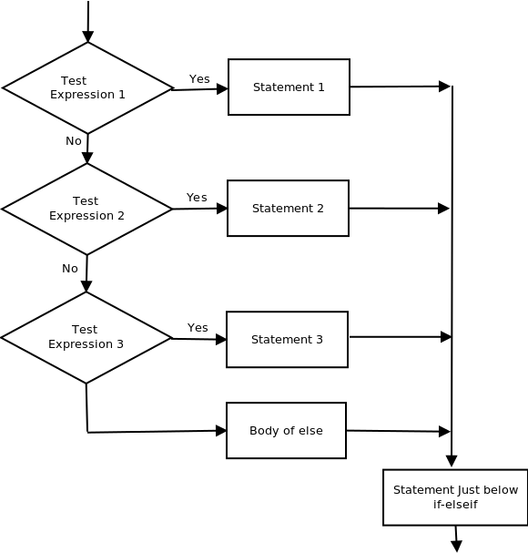
PL/SQL Conditional Statements
4. IF THEN ELSIF-THEN-ELSE Ladder
Here, a user can decide among multiple options. The if then statements are executed from the top down. As soon as one of the conditions controlling the if is true, the statement associated with that if is executed, and the rest of the ladder is bypassed. If none of the conditions is true, then the final else statement will be executed. Syntax:-
if (condition) then
--statement
elsif (condition) then
--statement
.
.
else
--statement
endif

Slide 14
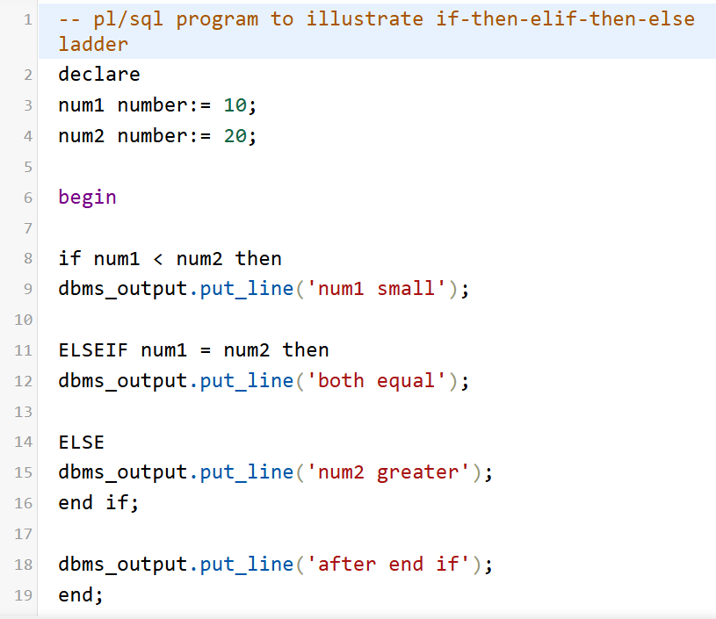
PL/SQL Conditional Statements
Output:-
num1 small
after end if

Slide 15

PL/SQL Iterative Control
Iterative control indicates the ability to repeat or skip sections of a code block.
A loop marks a sequence of statements that has to be repeated. The keyword loop has to be placed before the first statement in the sequence of statements to be repeated, while the keyword end loop is placed immediately after the last statement in the sequence.
Once a loop begins to execute, it will go on forever. Hence a conditional statement that controls the number of times a loop is executed always accompanies loops.
PL/SQL supports the following structures for iterative control:
Loop
WHILE loop
FOR loop

Slide 16

PL/SQL Iterative Control
Simple loop:
In simple loop, the key word loop should be placed before the first statement in the sequence and the keyword end loop should be written at the end of the sequence to end the loop.
Syntax:
Loop
< Sequence of statements >
End loop;

Slide 17
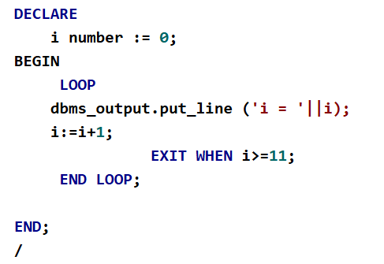
PL/SQL Iterative Control
Code:
Output:
i = 0
i = 1
i = 2
i = 3
i = 4
i = 5
i = 6
i = 7
i = 8
i = 9
i = 10

Slide 18
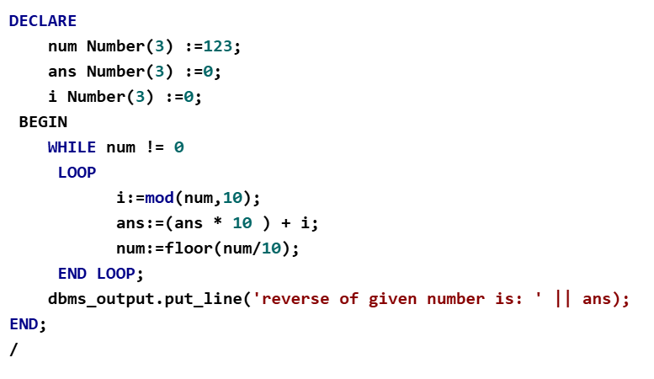
PL/SQL Iterative Control
WHILE loop
The while loop executes commands in its body as long as the condition remains true
Syntax :
WHILE < condition >
LOOP
< Action >
END LOOP
Output :
reverse of given number is: 321

Slide 19
PL/SQL Iterative Control
The FOR Loop
The FOR loop can be used when the number of iterations to be executed are known.
Syntax :
FOR variable IN [REVERSE] start..end
LOOP
< Action >
END LOOP;
The variable in the For Loop need not be declared. Also, the increment value cannot be specified. The For Loop variable is always incremented by 1.

Slide 20
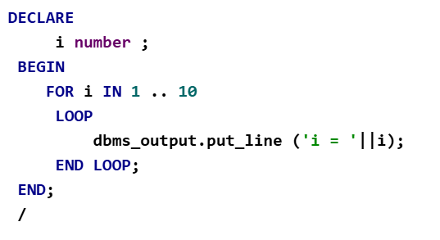
PL/SQL Iterative Control
Output :
Code:
i = 1
i = 2
i = 3
i = 4
i = 5
i = 6
i = 7
i = 8
i = 9
i = 10

Slide 21
PL/SQL Sequential Control
The GOTO Statement
The GOTO statement changes the flow of control within a PL/SQL block. This statement allows execution of a section of code, which is not in the normal flow of control. The entry point into such a block of code is marked using the tags «userdefined name». The GOTO statement can then make use of this user-defined name to jump into that block of code for execution.
Syntax :
GOTO jump;
....
<<jump>>

Slide 22
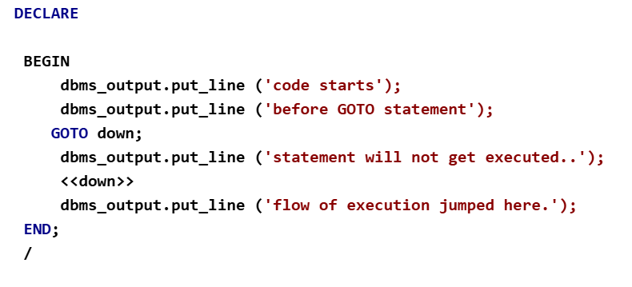
PL/SQL Sequential Control:
Code:
Output:
code starts
before gotostatements
flow of execution jumped here.

Slide 23
Cursors
Whenever DML statements are executed, a temporary work area is created in the system memory and it is called a cursor. A cursor can have more than one row, but processing wise only 1 row is taken into account. Cursors are very helpful in all kinds of databases like Oracle, SQL Server, MySQL, etc. They can be used well with DML statements like Update, Insert and Delete. Especially Implicit cursors are there with these operations. From time to time, it changes the values and hence the implicit cursor attribute values need to be assigned in a local variable for further use. In PL/SQL, two different types of cursors are available.
Implicit cursors
Explicit cursors

Slide 24
Cursors
Implicit Cursors
An Implicit Cursor is a cursor that is automatically created by the database management system to handle single-row queries or DML operations (INSERT, UPDATE, DELETE). The database automatically manages the lifecycle of an implicit cursor, so the programmer does not need to explicitly declare, open, fetch, or close it.
%ROWCOUNT
It displays the number of rows produced by a SELECT INTO command or affected by DML operations like INSERT, DELETE, and UPDATE.

Slide 25
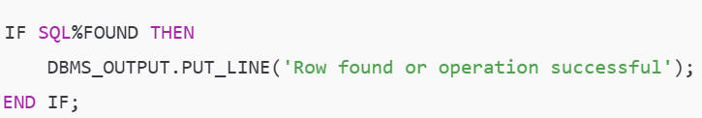
Cursors
%FOUND
Its return result is TRUE if a SELECT INTO command produced one or more rows, or if DML actions like INSERT, DELETE, and UPDATE influence at least one row or more rows. Otherwise, FALSE is returned.

Slide 26

Cursors
%NOTFOUND
Its return result is TRUE if a SELECT INTO command produced one or more rows, or if DML actions like INSERT, DELETE, and UPDATE influence at least one row or more rows. Otherwise, FALSE is returned.
%NOTFOUND
Its return result is TRUE if no rows are affected by DML operations like INSERT, DELETE, and UPDATE, or if a SELECT INTO command returns no rows. Otherwise, FALSE is returned. It is directly opposed to %FOUND.

Slide 27
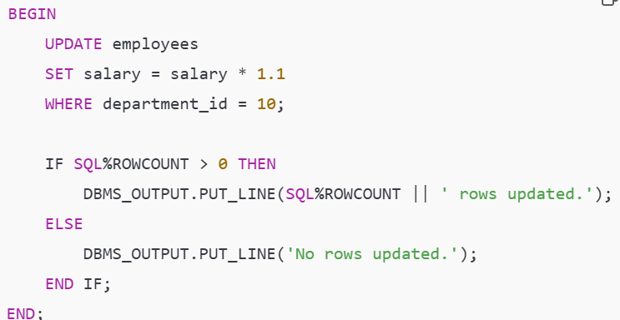
Cursors
Example of an Implicit Cursor:

Slide 28

Cursors
Advantages of Implicit Cursors:
Simplifies coding for basic queries and DML operations.
Automatically managed by the DBMS, reducing programmer effort.
Suitable for operations involving single rows or simple data manipulation.
Disadvantages of Implicit Cursors:
Limited to single-row queries or operations.
Lack of control for handling multi-row query results (use explicit cursors for this).

Slide 29

Cursors
An Explicit Cursor is a database object that allows programmers to handle multi-row query results in a controlled manner, processing each row one at a time. Unlike implicit cursors (which are automatically created by SQL for single-row operations), explicit cursors must be explicitly declared, opened, fetched, and closed by the user.
Steps for Using an Explicit Cursor:
Declare the Cursor: Define the cursor and associate it with a SELECT query

Slide 30



Cursors
Open the Cursor: Execute the query and make the result set available for processing.
Fetch Data: Retrieve one row at a time from the result set.
Close the Cursor: Release the resources associated with the cursor.

Slide 31
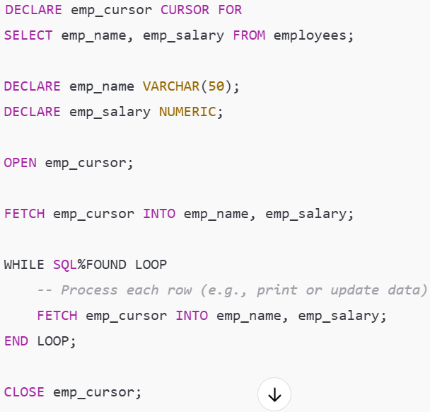
Cursors
Example of an Explicit Cursor:

Slide 32

Cursors
Advantages of Explicit Cursors:
Provides control over row-by-row processing.
Enables complex operations on individual rows of a query result set.
Disadvantages:
Slower performance compared to set-based operations.
Increases code complexity.

Slide 33
Views
Views in SQL are a type of virtual table that simplifies how users interact with data across one or more tables. Unlike traditional tables, a view in SQL does not store data on disk; instead, it dynamically retrieves data based on a pre-defined query each time it’s accessed.
SQL views are particularly useful for managing complex queries, enhancing security, and presenting data in a simplified format
How Views Work in Cursors
View Definition: A view is created as a virtual table that combines data from one or more tables. You can create a cursor to process rows from a view instead of directly querying the underlying tables.
Cursor Usage: The cursor can reference the view in its SELECT query to retrieve and process data row by row.

Slide 34
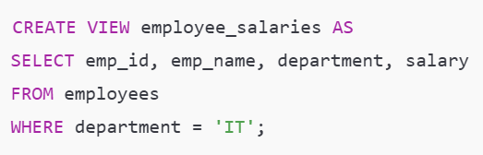

Views
Steps to Use a Cursor with a View
Create the View: Define the view using a CREATE VIEW statement.
Declare the Cursor: Use the view in the SELECT query for the cursor declaration.

Slide 35


Views
Open the Cursor: Execute the query to make the result set available for processing.
Fetch Rows from the Cursor: Retrieve rows one at a time from the cursor.
Process Each Row: Apply desired logic (e.g., calculations, updates) to the fetched data.
Close the Cursor: Release resources after completing processing.

Slide 36


Views
Advantages of Using Views in Cursors
Simplicity:
Views can encapsulate complex queries, making the cursor's logic simpler.
Reusability:
A view can be reused across different queries or cursors.
Data Abstraction:
Views abstract the underlying table structure, providing a layer of security and modularity.

Slide 37
THANK YOU

